Slide 1

Department of Software Engineering(SWE) Project Course Title: Softwer Requirement Specification & Analysis Course Code: SE-212 Submitted To: Department Head: Dr.Imran Mahmud Dept.of SWE Submitted By:
Md.Abdullah al mamun
Id:201-35-3087
Sec:C

Slide 2
Project Name:mama jabo/মামা যাব By Cng User Driver

Slide 3
Table Of Content
1.User Profile
2.Function Requirement
3.Use Case Diagram
4.Story Board

Slide 4
User Profile: Mama jabo/Driver
Type of user | primary
Age Range | 18-50
Frequency of use | Unlimited
Mandatory/Voluntary | Voluntary
Computer Experience | Not Required
Goals | App To Take a Ride
Language | Basic English/Bangla
Education | Not Required
Number of users | unlimited
Training | Required
Other System used | Not Required
Way of Working | Need Smart Phone,Need Internet phone,Mobile GPS,Phone Sim Card

Slide 5
List of Functional Requirements Functional Requirement: For Driver
Requirement Id | FR p.1
Requirement Name | Select Language
Description | Driver can select language
Requirement Id | FR p.2
Requirement Name | Create Account
Description | Driver can create their user account
Requirement Id | FR p.3
Requirement Name | Location
Description | Driver can location his/her Location
Requirement Id | FR p.4
Requirement Name | Bid
Description | Driver can bid rid

Slide 6

Use Case Diagram
Log in
Registration
View Driver Profile
Confirm Mama Jaiba
Bid
Driver
Payment
Edit Profile

Slide 7

Welcome Mama Jabo App
English
বাংলা
Next

Slide 8
Jabo
Driver
Enter your mobile number
Enter your Password
LOGLN
FORGOT PASSWORD?
Create New Account

Slide 9

Enter your mobile number
+880
Next

Slide 10
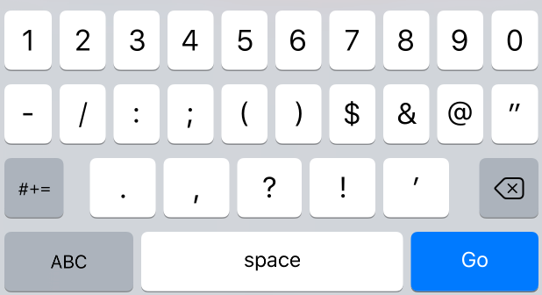
Enter the 4-digit code send
to you at+8801827****33
1
5
8
4
Resend code in 00.11
Next

Slide 11
Select City
Dhaka
Chittagong
Khulna

Slide 12

PERSONAL INFORMATION
Take your photo
Full Name (same as NID/License)
adress
Next

Slide 13

Sing Up For CNG
CNG NUMBER
Dhaka Metro
x
15-0000
CNG MODEL
xxxxxxxx
Next

Slide 14

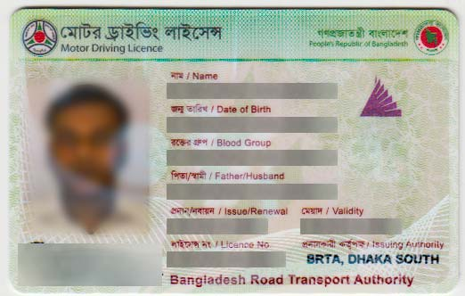
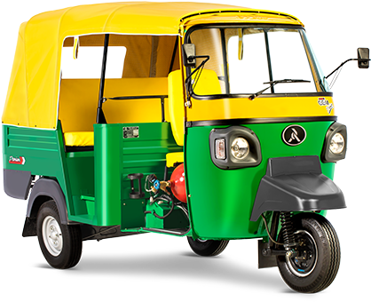
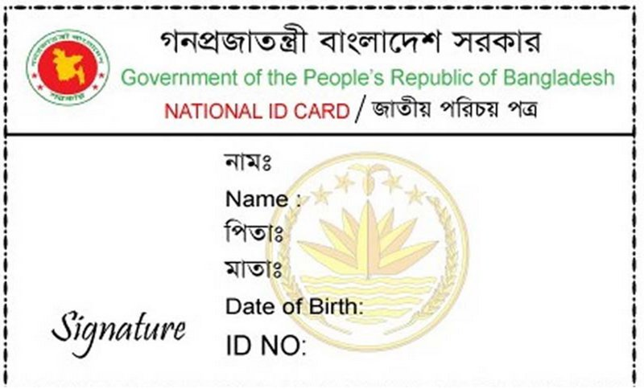
Document
Any paper on the CNG given BRTA
Picter of the car with number plate
your national identity card
Next

Slide 15
Select your password
Confirm your password
Next

Slide 16

Account Done

Slide 17



Mama jabo
Select your current location
Hazaribag
Click to take a trip
Next

Slide 18

Mama jabo
Trip 1
Hazaribag
Rode 49/e
House26/5/Ka,Moneshware lane
Dhanmondi 15 number
Trip 2
23,Hazaribagh Rd
Dhanmondi 32
Confrim
1

Slide 19
Please Bid
Hazaribag
Rode 49/e
House26/5/Ka,Moneshware lane
To
Dhanmondi 15 number
Taka
100
Confirm

Slide 20

Mama jabo
Bid win
Next

Slide 21

Receive Passengers
Cng Start
Let’s go destiation

Slide 22
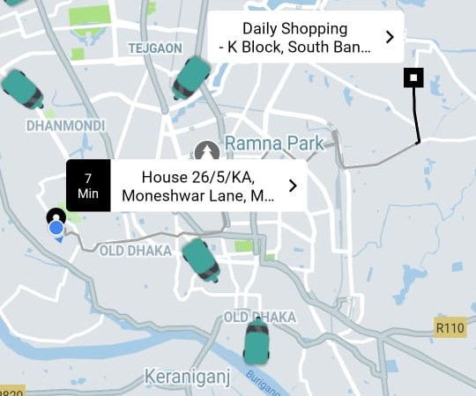


End Trip

Slide 23
Taka Receive type
Cash
or
Mobile Bank
Cash
Receive Taka

Slide 24
Back Home

